Slide 1
Talking about a special day
Área Académica: Ingeniería Mecánica
Profesor(a):L.E.L.I. Leticia Sánchez Franco
Periodo: Julio-Diciembre 2016

Slide 2

Resumen
Cuando nos referimos a eventos pasados, es común mencionar algunos detalles que describan dicho suceso, el lugar y los sentimientos de los participantes, es en este caso cuando utilizamos la estructura del verbo «be» en pasado.
Abstract
When we speak about the past, it is common to mention some details that describe the event, the place and the participants´ feelings. In this case we use the structure of the verb be in past.
Key words: was, were, amazing, there was, there were, etc.

Slide 3
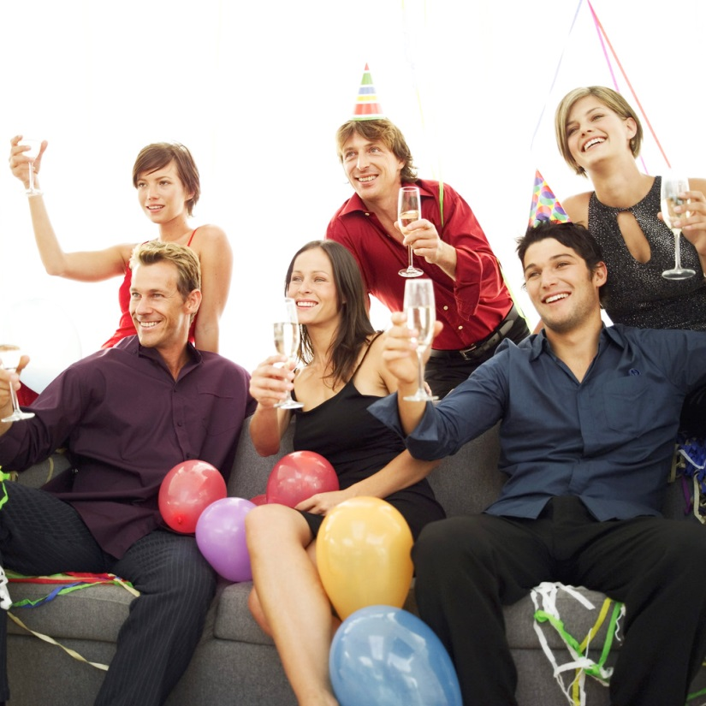
Describing places and special celebrations

Slide 4

I am from Costa Rica, but I live in the U.S. I live with my parents. I don’t have any brothers or sisters. Yesterday was my birthday and about twenty friends were here. There was a lot of delicious food and drink- pizza, cake, snacks, soda, and fruit water. It was a great party, and I was very happy. There was a DJ., and the music was great.

Slide 5
We use the verb BE (was/were) to describe people, things, places , feelings and
situations in the past.
Personal pronoun | BE | Complement
I | was | at home. happy. late for school .
You | were
He | was
She
It
We | were
They
Yesterday…

Slide 6
Verb to be
Past Tense
Affirmative I He She was It We You were They | Negative I He She was not It (wasn’t) We You were not They (weren’t) | Interrogative I Was He … ? She It We Were You … ? They | I Yes, He was She It No, …… wasn’t We Yes, You were They No, ……weren’t
We use this verb to describe people, things, places , feelings and
situations in the past.

Slide 7
Wh Questions with the verb BE
Question Word | Was /were | Subject
When | was | the party?
How | was | the weather?
Where | were | you?

Slide 8
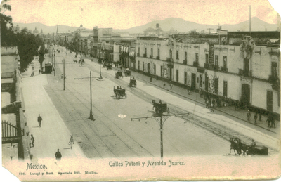
Mexico City in 1900
There were a lot of second-floor buildings.
There weren’t a lot of people.
There were some carriages.
There wasn’t any traffic.
There was a railroad.
In 1900, Mexico City was a quiet, clean and small city. The streets were empty.

Slide 9
What existed in a place
There was / wasn’t + singular or uncountable nouns
There was a railway in the city.
There was a lot of food
There wasn’t any cake.
There were /weren’t + plural nouns
There were some buildings.
There were 200 people.
There weren’t any seats in the concert.

Slide 10
Yes/No Questions | Short answers
Was there any traffic? | Yes there was | No, there wasn’t.
Were there any cars? | Yes, there were. | No, there weren’t.
Information Questions | Short answers
What transportation was there? | Carriages and train.
How many people were in the street? | There were a few people.

Slide 11
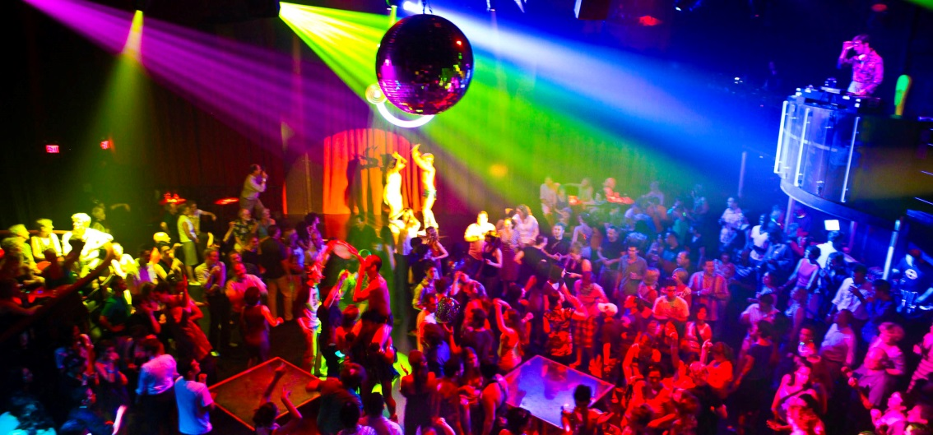
Practice describing special days
The concert was amazing. The music was great. There were a lot of people. They were excited and happy.

Slide 12
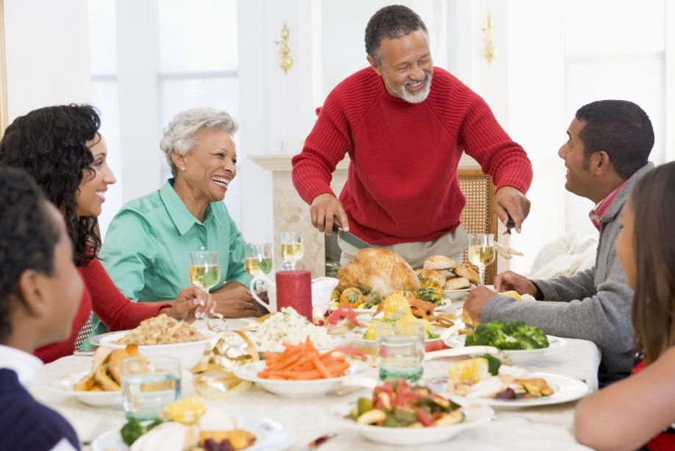
Practice describing special days
Last Christmas dinner was great. There was a lot of food. My family was happy. There were presents for everyone

Slide 13
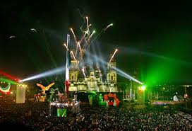
Practice describing special days
The Independence celebration…

Slide 14
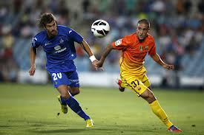
Practice describing special days
The soccer match ….

Slide 15
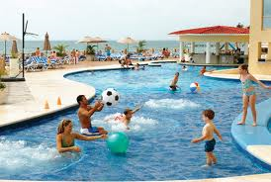
Practice describing special days
Last vacation …

Slide 16
Referencias
Evans V. & Dooley J. (1998). Enterprise 1 Coursebook Beginner. Express Publishing.

